Slide 1
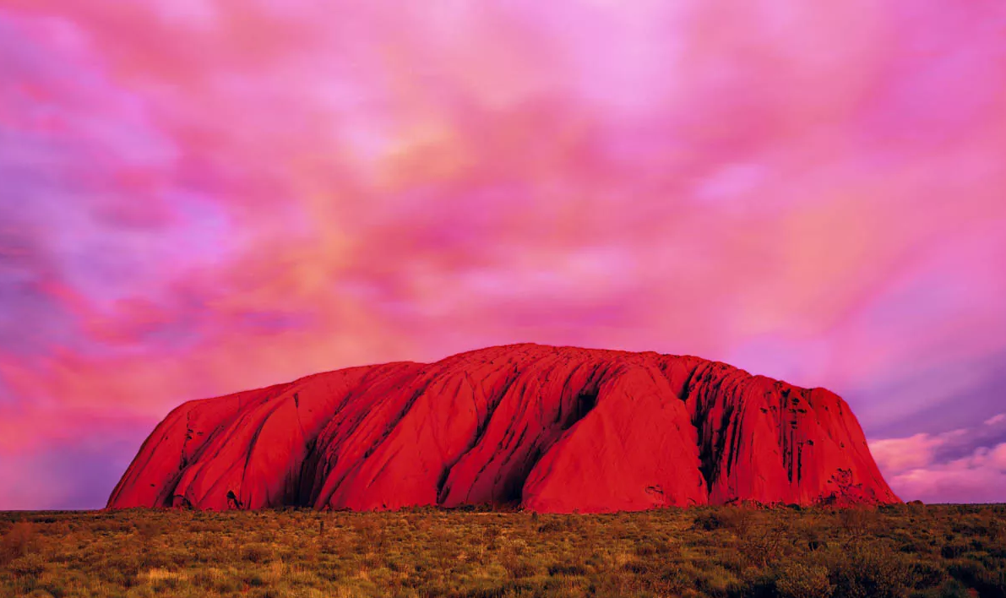
SIMPLIFYING NT VISIT PLANNING: A DATA-DRIVEN APPROACH TO A USER-FRIENDLY WEBSITE
Hello NT
Your Digital Itinerary Planner
Sober Tiramisu
September - 2024

Slide 2
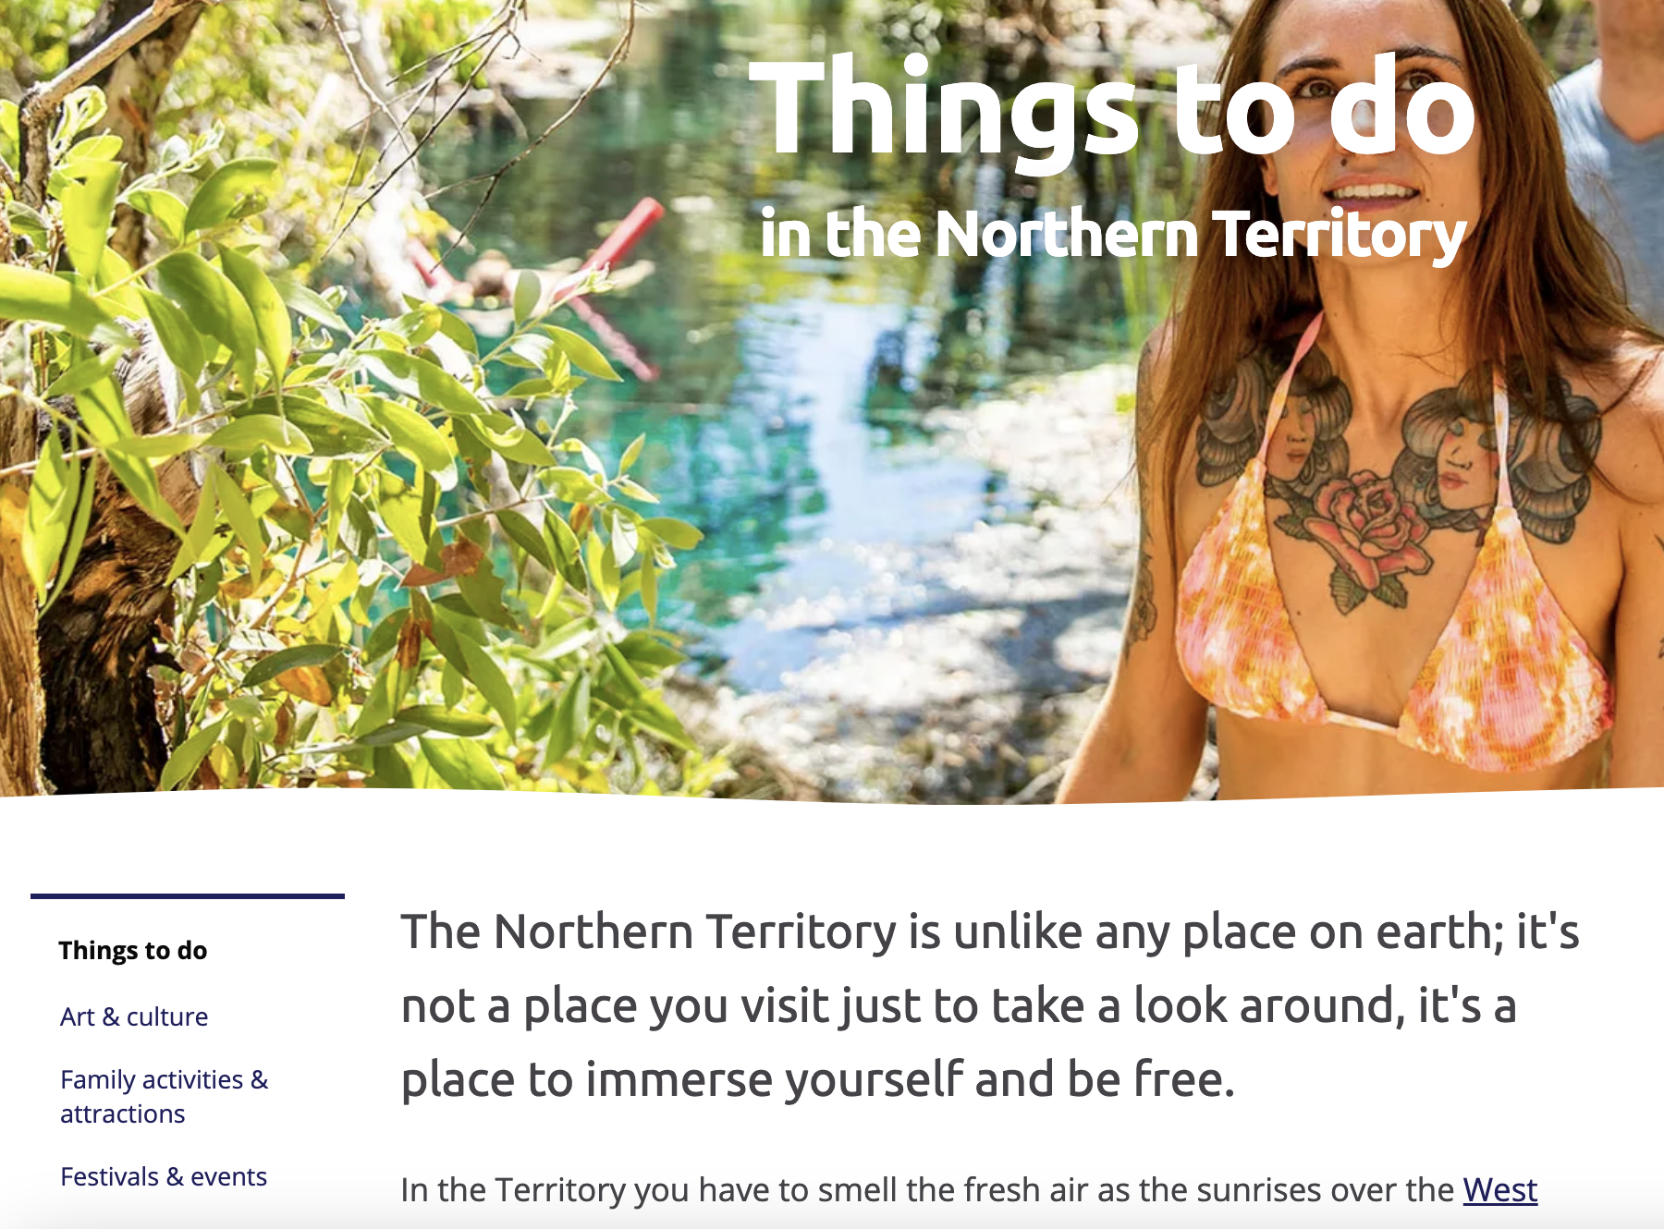
Problem Statement
User Pain Points
Travelers visiting website that can miss out on underrated spots
Too many links in one paragraph from official website can create confusion
Important info like cost of venue, time spent and weather is hard to find.
Notes:
Overwhelming and

Slide 3
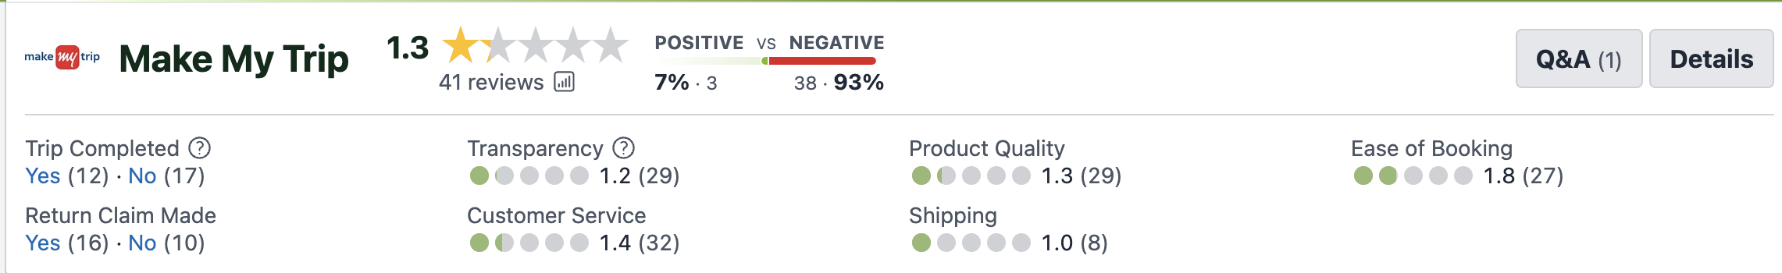
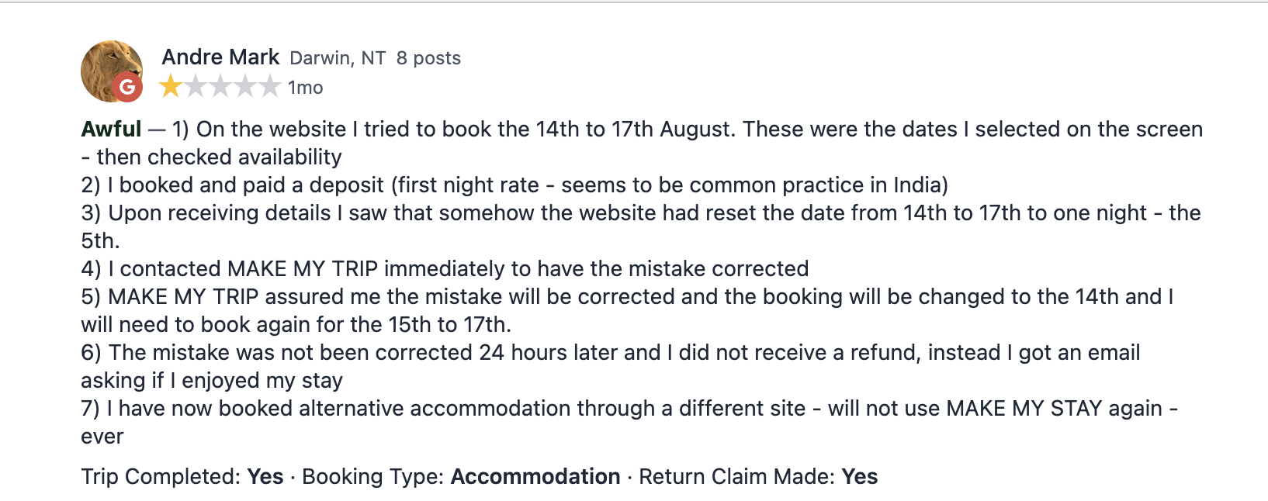
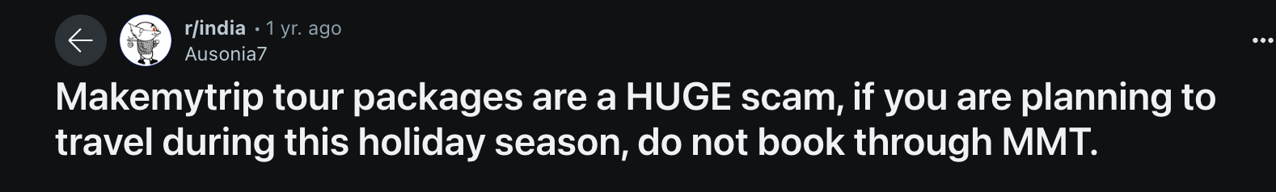
Evidence of Problems
Lack of clarity regarding booking details
Users faced errors with booking dates and modifications
Poor customer service response times and unhelpful interactions
Booking accommodations seems complicated on these platforms, leading to user frustration
Overall Trust and Credibility

Slide 4
Visiting NT
Holidays and Trips have reduced considerably as the main purpose of visiting NT
Purpose of Visiting NT | Classification Change (%)
Holidays | -41%
Visiting Friends and Family | +29%
Business Trips | +2.8%
Other (Education, Employment, etc.) | +7.2%

Slide 5
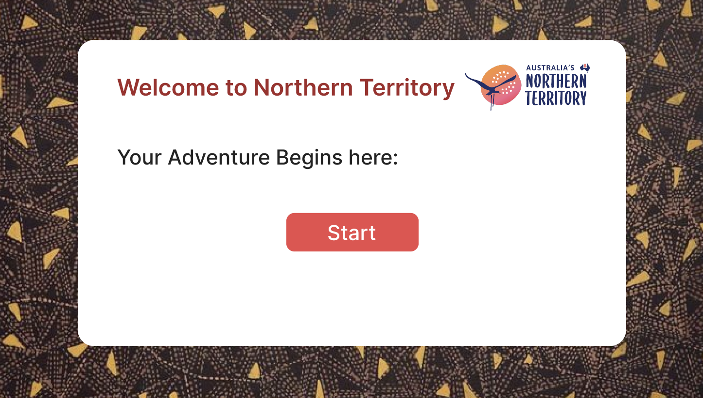
About the Webapp
The webapp
Interactive website for easy planning
Budget planner
Personalized trip generation
Weather forecast
Google trip link generation
Ease of use
Option to edit locations
ML Model to generate trip
Target Audience
Visitors travelling for holiday purposes
School trips
Bag packers

Slide 6
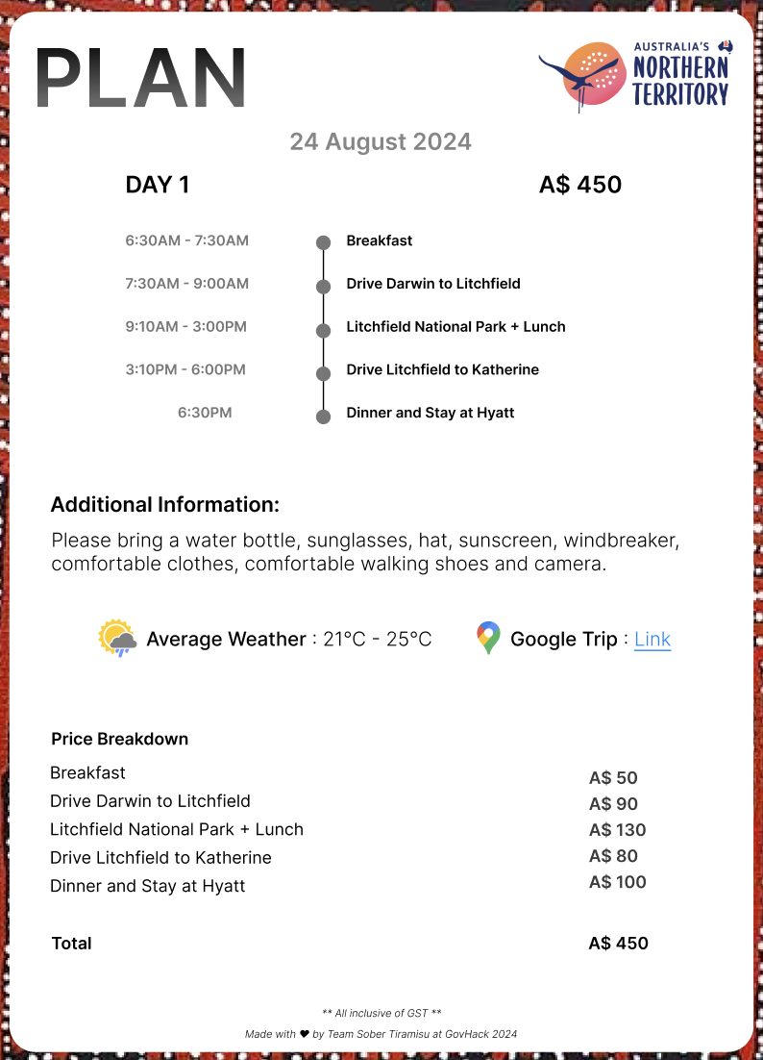
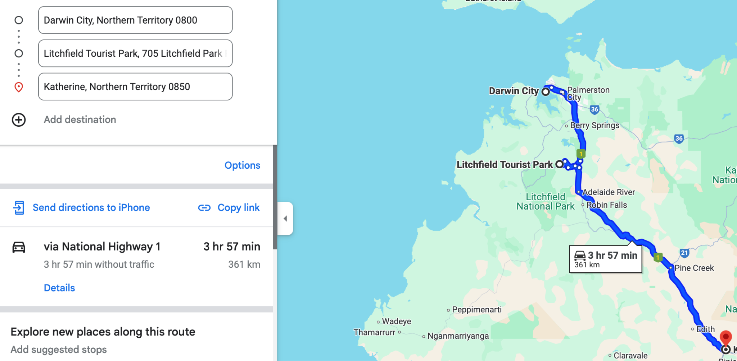
Solution
The revamped website features a minimalist and interactive design, focusing on enhancing user experience and simplifying trip planning processes.
https://www.figma.com/proto/NPXqmANahseqlS4hfRcQKZ/GovHack-2024?node-id=0-1&t=2kIR6BNHljEk6wDD-1

Slide 7
Benefits and Impact
Enhanced User Satisfaction and Planning Efficiency
Digital Marketing Strategies
Improved User Engagement
Increased Number of Tourists, Therefore Increased Revenue for the State

Slide 8
Conclusion & Call to Action
Low tourism in Northern Territory
WebApp that creates personalized trip
Simplified budget focused itinerary creation
Elevate existing tools such as Maps for convenience

